Slide 1
Stock Market Prediction using LSTM
Team Members:
Pranav Prabhat Sinha (RA2211047010105)
Ananyashree (RA2211047010117)

Slide 2
ABSTRACT
Objective: Analyze stock market data for selected technology stocks (Apple, Amazon, Google, Microsoft).
Tools: yfinance, Seaborn, Matplotlib.
Assess stock risk based on historical performance.
Introduce LSTM for time-series forecasting.
Setup LSTM model for predicting future stock prices.
Train model and evaluate using RMSE.
Present results of LSTM predictions.

Slide 3
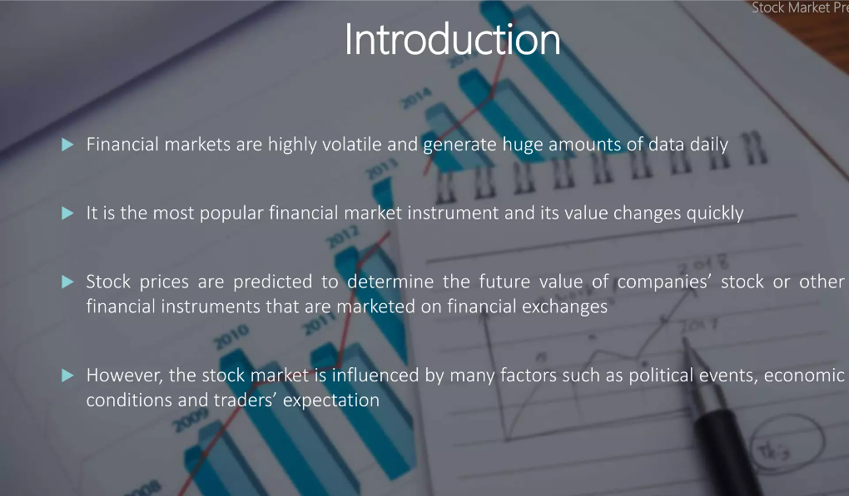

Slide 4
SURVEY
S.NO | Author | Year | Model | Metrics | Results | Drawbacks
1 | Poonam Somani | 2014 | HMM | Accuracy, MAPE | 3.9(MAPE) | Less performance
2 | Haryati Setyorini | 2020 | XGBoost and LSTM | RMSE,LOSS,Accuracy | 94.79% accuracy | Less increase compared to XGBoost
3 | K. Ritwik Reddy | 2022 | RNN | MAPE | 4.14 | optimisation
4 | Jesús Padilla-Caballero | 2023 | Soft computing,GA | graph | none | none

Slide 5
RESEARCH OBJECTIVE
Implement Long Short-Term Memory (LSTM) neural network models to forecast future stock prices for selected technology companies (Apple, Amazon, Google, Microsoft).
Evaluate the accuracy and effectiveness of LSTM-based predictions compared to traditional forecasting methods.
Analyze historical stock performance to assess the risk associated with investing in the selected companies.
Compare the performance of LSTM models with alternative predictive techniques, such as statistical methods or machine learning algorithms.
Identify potential areas for further research, including the integration of additional data sources or the refinement of neural network architectures.

Slide 6
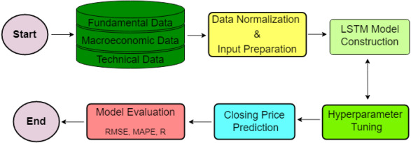
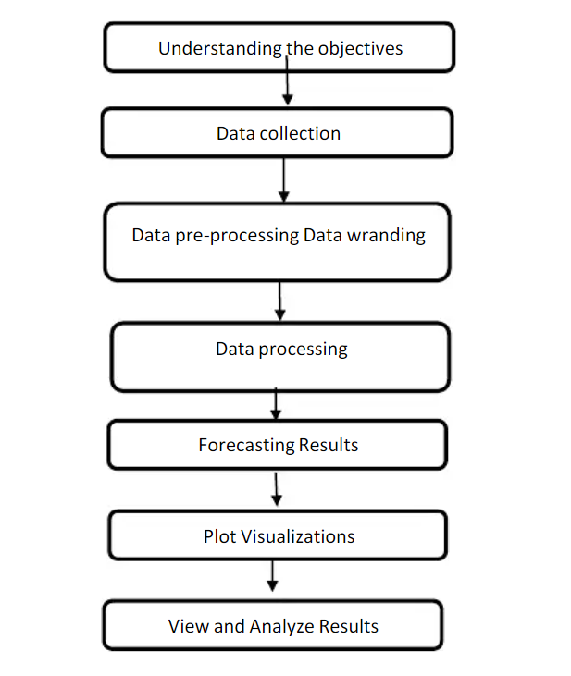
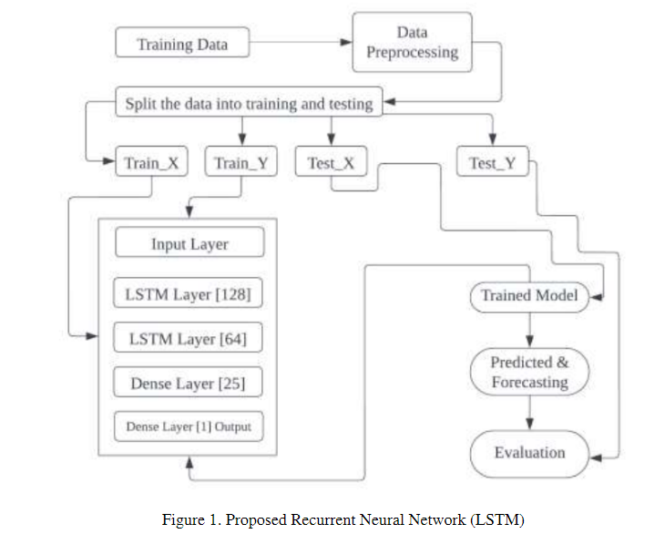
PROPORSED ARTITECHURE

Slide 7
Experimental Results
SVM | KNN | Decision-Tree | Naïve Bayes | LSTM(RNN)
Precision: 0.89 Accuracy: 0.91 | Precision: 0.76 Accuracy: 0.78 | Precision: 0.71 Accuracy: 0.72 | Precision: 0.76 Accuracy: 0.78 | RMSE:4.4 Mae: 3.76

Slide 8
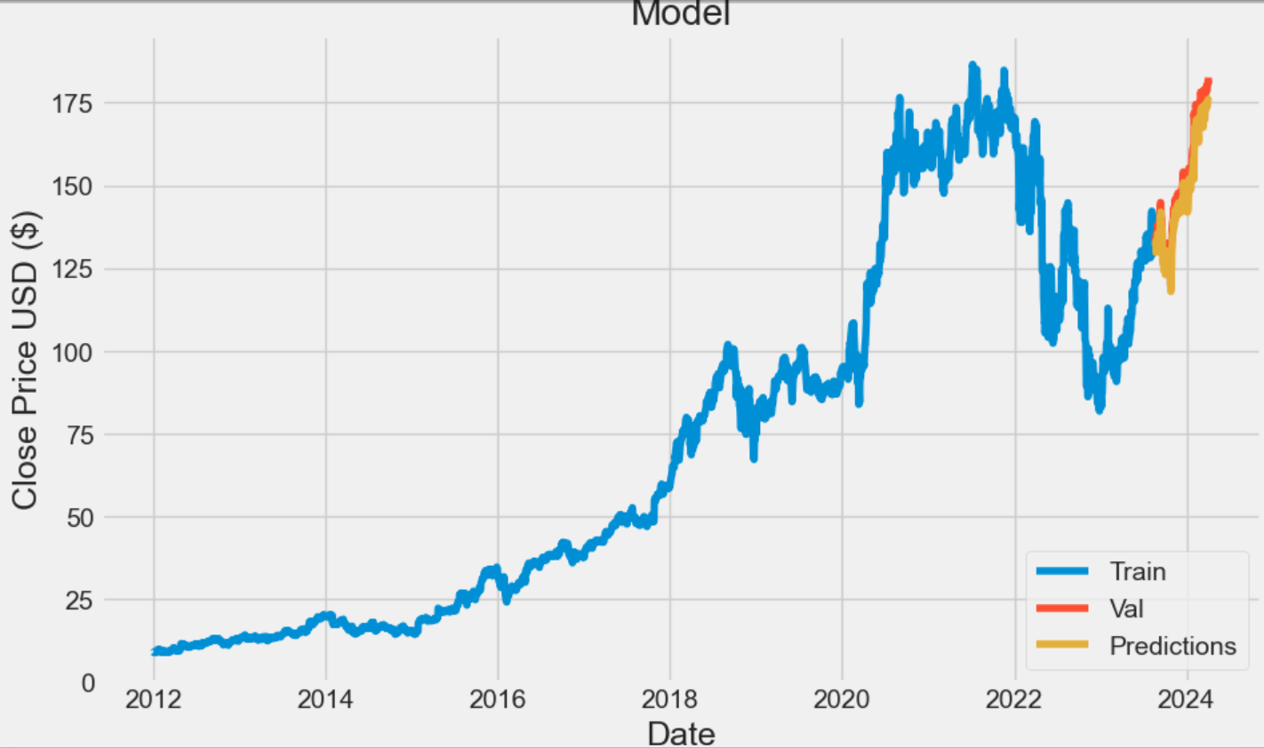

Slide 9
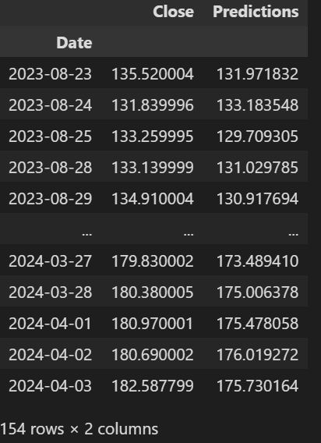
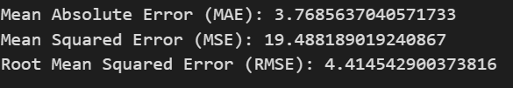
OUTPUT

Slide 10
CONCLUSION
The utilization of Long Short-Term Memory (LSTM) neural network models has shown promising results in forecasting future stock prices.
LSTM models demonstrate the ability to capture complex patterns and dependencies in stock market data, contributing to more accurate predictions.
The success of LSTM models in stock prediction opens avenues for further research and development.
Our analysis of historical stock performance has provided insights into the risk associated with investing in technology companies.
By identifying key risk factors and understanding their impact on stock volatility, investors can make informed decisions to mitigate risks.

Slide 11
REFERENCE
Boosting the Accuracy of Stock Market Prediction using XGBoost and Long Short-Term Memory
Agustinus Bimo Gumelar;Haryati Setyorini;Derry Pramono Adi;Sengguruh Nilowardono;Latipah;Agung Widodo;Achmad Teguh Wibowo;MY Teguh Sulistyono;Evy Christine2020 International Seminar on Application for Technology of Information and Communication
Stock Market Prediction Using Recurrent Neural Network
K. Ritwik Reddy;B. Tarun Kumar;V. Rohit Ganesh;Polisetty Swetha;Prakash Kumar Sarangi
2022 IEEE International Conference on Current Development in Engineering and Technology
Research on Influential Factors in Stock Market Prediction with LSTM
Xu Zhang;Li Zhang;Lingjun Xu;Yue Jiang
2022 7th International Conference on Big Data Analytics (ICBDA)

